Slide 1
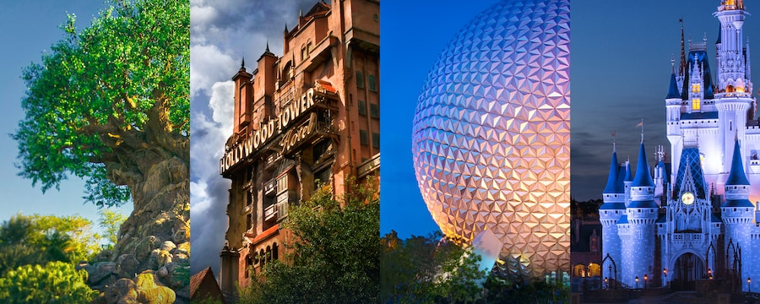
Walt Disney World Ride Data
By Hailey Skoglund, Gus Lipkin, Alex Pierstorff

Slide 2
Research Questions
Does hot weather increase wait times for rides with a ”splash aspect"?
Does rainy or hot weather cause an increase in wait times for "indoor rides"?
Determine the busiest day of week and busiest month of the year (lubridate data) for tourists to visit WDW.
Create a structed travel plan for tourists to minimize the amount of time spent waiting in line.

Slide 3
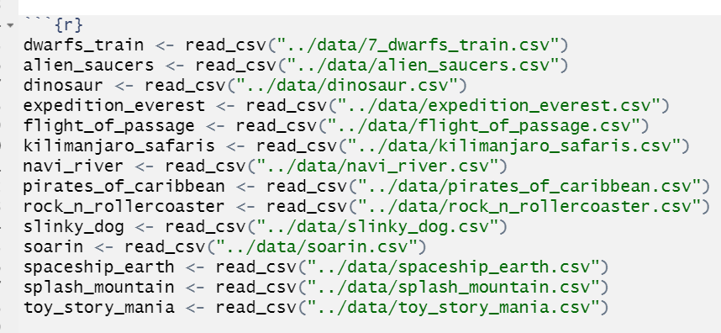
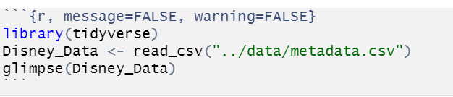
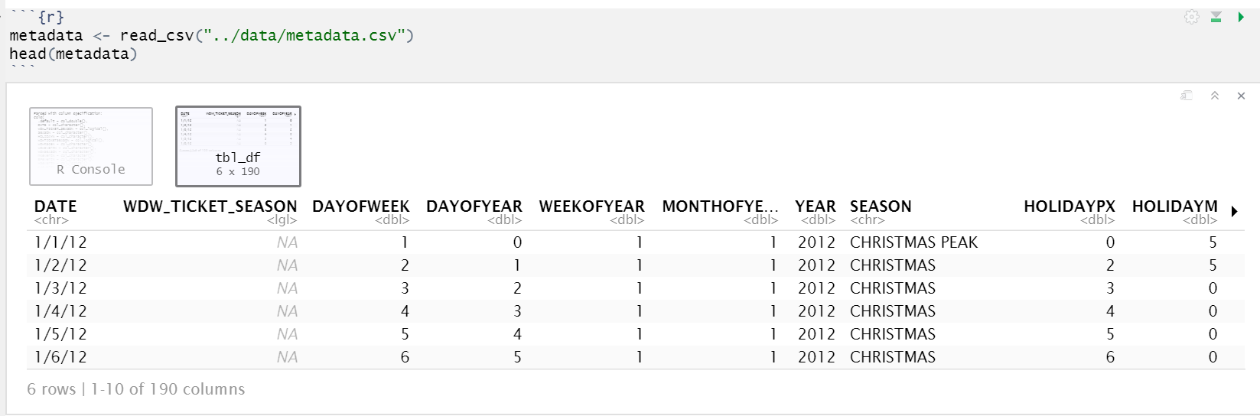
Data Involved
Lots of Datasets!
Metadata includes:
Dates
Ticket sales seasons
Holidays
School sessions nearby
Rides_df includes:
Information on each of he 14 rides analyzed
Compilation of each individual ride’s dataframe
Individual Rides: 14 dataframes
Individual ride’s names
Wait times
Reported , actual, and average wait times
date

Slide 4
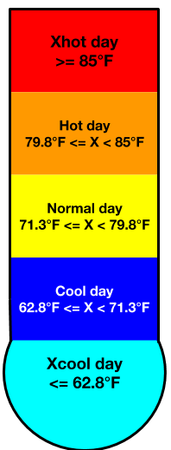
Analysis Performed
Temperatures
Organized temps into categories based on mean temperatures
Parade Times
Visualization showing wait times in proximity to parade start times.
Rainfall
Explored relationship between average precipitation and wait times.
Busiest Seasons
Used lubridate package to identify the busiest dates of the week, month, and year
Holiday Proximity
Analyzed peaks in wait times in relation to proximity of seasonal holiday events.

Slide 5
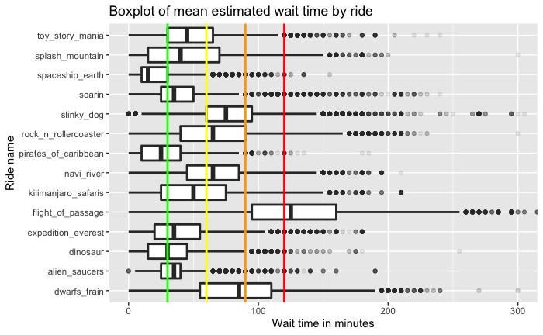
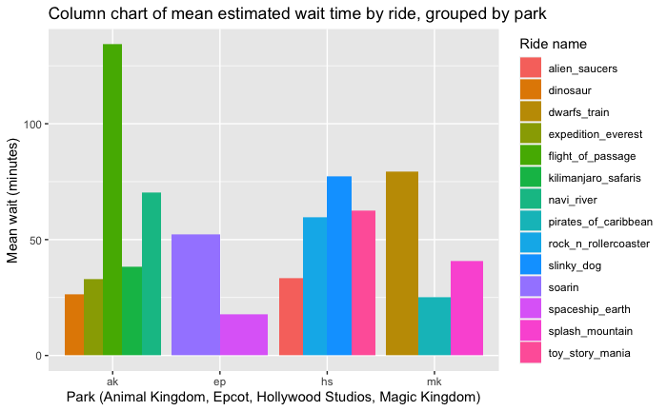
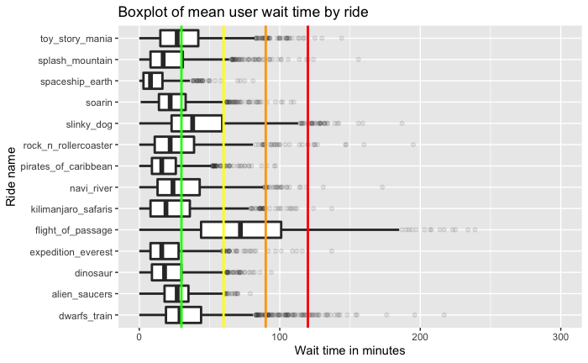
Visualizations
Wait times are recorded as either park reported estimates or user reported actual times
Notes:
Boxplots
These boxplots show the wait times for each ride.
LT Reported estimated wait times from WDW
RT Actual reported wait times from guests
Separated with vertical lines in 30-minute increments.
30 min - 2 hours

Slide 6
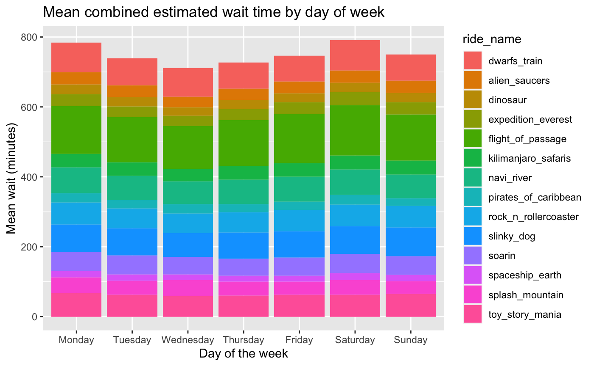
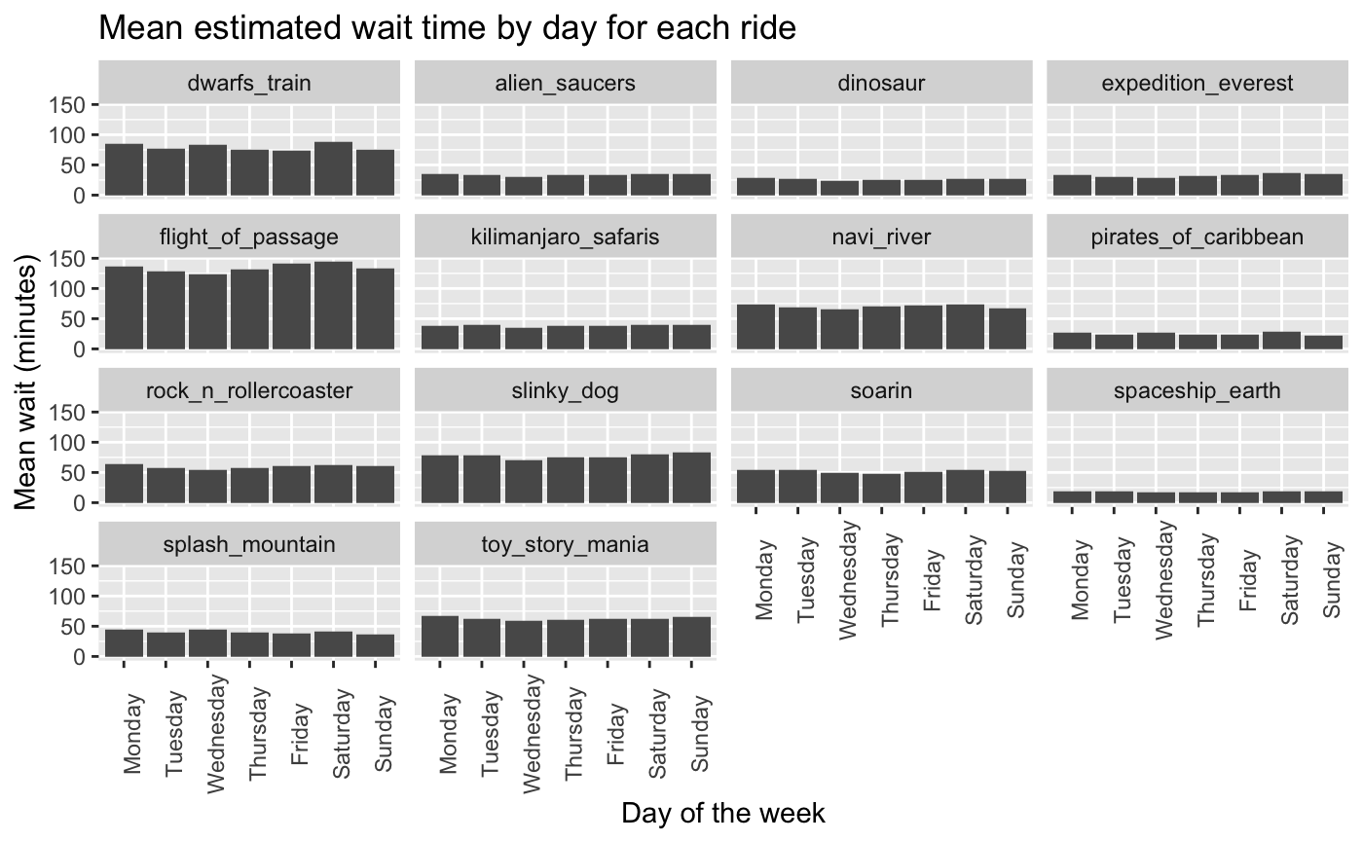
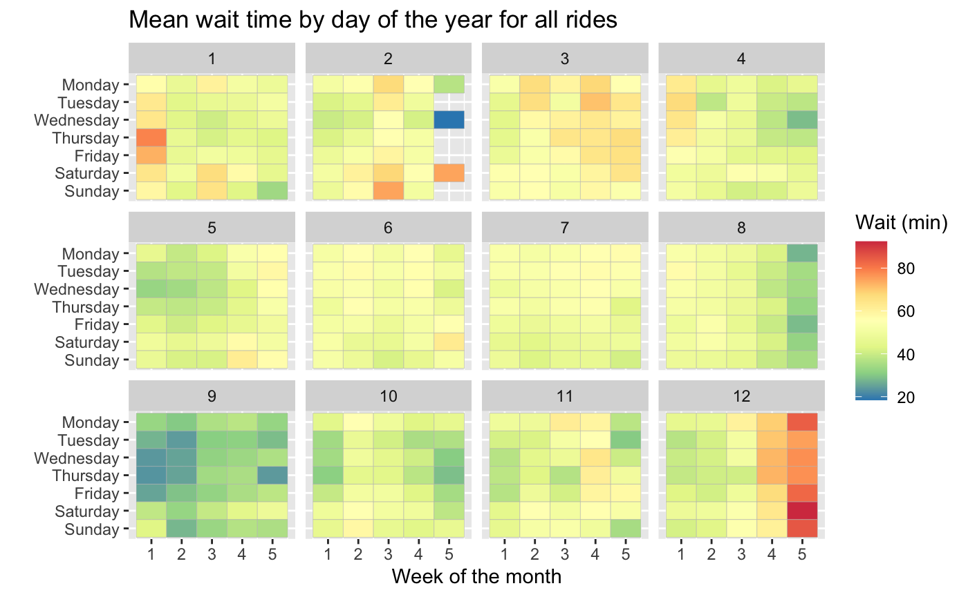
Visualizations
Bar graphs
Shows the average wait times of each of the rides throughout the week.
Compares wait times of each ride for each day of the week in a side-by-side visualization.
Tile graph
Shows which week of each month is the busiest by showing

Slide 7
Summary & Conclusion
Correlations:
Temperature and types of rides:
Hot days and inside air-conditioned rides
Cold days and water rides
Rainy Weather
Increases wait times
Seasonal High's and Low's:
September return to school
December Holiday season
Parades
Slight increase in wait times due to crowds following parades
New Attractions
High wait times associated with opening days
Optimal Travel Plan:
September
Wednesday
Epcot
Spaceship Earth first, then Soarin’
Notes:
- Does hot weather increase wait times for rides with a "splash_aspect"?
Yes! Hot weather causes outdoor splash-aspect rides to have a significantly higher wait time than on cooler days.
- Does rainy weather cause an increase in wait times for "indoor_rides"?
Yes! Rainy days cause there to be a distinct increase in the wait times for indoor rides.
- What is the busiest Day of week (lubridate data) for tourists to visit WDW?
Based on wait times, the busiest day of the week to visit WDW is Saturday.
- What affect do parades have on the wait times of rides?
Parades cause a slight decrease in wait times.

Slide 8
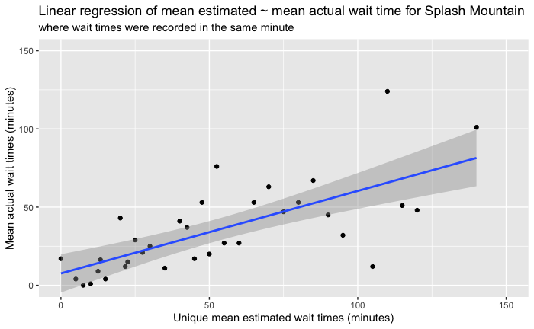
Next Steps
Linear Regression:
Allows us to directly compare how different factors affect wait times
We can look at the charts we made and see which variables have the biggest affect and use those as wait time predictors
Example regression:
Are estimated wait times a good predictor of actual wait times?
We filter where there is an estimated and user recorded wait time during the same minute and then get only unique estimated values
Adjusted r² = .4836
p-value = 3.012e⁻⁶
Conclusion:
Not particularly based on this data

